Slide 1
Lecture 4: The Powers of the Sovereign

Slide 2
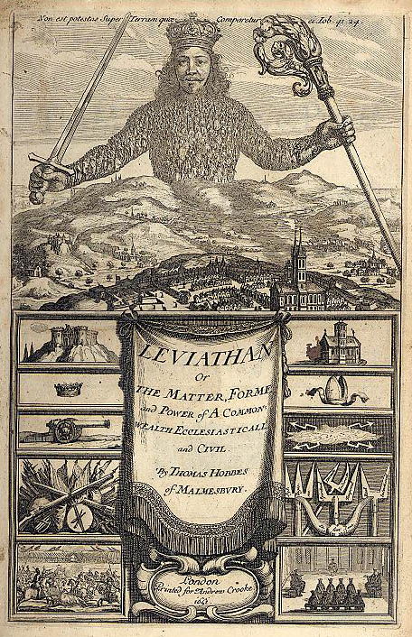
The Commonwealth

Slide 3
The Commonwealth
A political authority which exercises sovereign power over us and is founded on the basis of the social contract
It fear of punishment that we obey the law - a power “to keep us in awe”.
Obedience to the law is the basis of any political community.
Commonwealth is sovereign – the ultimate authority in society
Function of the sovereign is to protect members of society both from external attack and from each other.
This sovereign power has the same authority over its subjects that parents have over their children.

Slide 4

Different Kinds of Commonwealth
Monarchy – Rule of One
Democracy – Rule of All
Aristocracy – Rule of Several

Slide 5

UK Political System
Parliament
↓
PM and Cabinet
Parliamentary sovereignty
No separation of powers
Flexible constitution
Weak judicial review
Weak bicameralism
Unitary state

Slide 6
US Political System – Separation of Powers
Congress ↔ President ↔ Supreme Court
Separation of powers
Checks and balances
Constitution/Bill of Rights/Judicial Review
Strong bicameralism
Party fragmentation
Federalism

Slide 7
Powers of the Sovereign
Above the law
Requires absolute obedience.
Can never be accused of injuring or acting unjustly towards his subjects
Cannot be punished or put to death by his subjects
The judge of all opinions and doctrines
Has power to determine rules regarding what goods people may enjoy and what actions he may do without being interfered with by fellow subjects.
Determines rules of propriety and civil law.
Has the right to judge – the right to hear and decide cases (to be the judiciary).
Has right to make war and peace with other countries.
Has right to levy money to raise armies and to command military action
Has right to choose all counsellors, ministers, magistrates.
Has the power to reward with riches and honours; and punish with corporal or pecuniary punishment.
Has power to execute laws; also to appoint order of place and dignity; to determine signs of respect that people shall give to others.

Slide 8
The Commandments of the Sovereign
Subjects should be taught the following in order to ensure
their ongoing obedience:
To not admire other forms of govt in foreign countries – to be loyal to their own.
To not admire too much one of their fellow citizens
To not speak ill or irreverently of the sovereign
To set aside some time to gather together so that they can be taught their duties (like keeping the Sabbath)
That parents teach obedience to the sovereign to their children
Children should be taught the principles of justice

Slide 9
Crime in the Commonwealth
To commit a crime is not only to break the law but to transgress the authority of the sovereign.
Crime must be distinguished from sin – every crime is a sin, but not every sin is a crime.
Crime emerges from defect of understanding or reason (ignorance); or from a sudden passion.
Ignorance of the law – no excuse
Ignorance of the sovereign – no excuse
Ignorance of the penalty – no excuse
Law cannot be applied retrospectively – goes against principle of natural justice.
Not all crimes are the same, not all equally unjust – for some there is an excuse or extenuating circumstances;
  If a person does not have the mental faculties to understand law (children, madmen)
  If a person is forced on pain of death to break the law
  If a person breaks the law to preserve himself – steals food if he is starving (during a famine)

Slide 10
Civil Liberties in the Commonwealth
New definition of liberty: what is permitted by civil laws (or by their absence)
People have the liberty that the sovereign permits them by not making laws to prohibit it (what Hobbes calls civil liberty as opposed to natural liberty):
People have liberty to buy, sell, contract one another, travel, choose their own diet, their own profession, deal with their children as they see fit etc
There are also a number of things which we can justly refuse to do even if commanded to by the sovereign – eg. natural rights of self-preservation
Other liberties depend on the silence of the law: in other words, citizens are allowed to do whatever is not expressly prohibited by the law.

